Slide 1
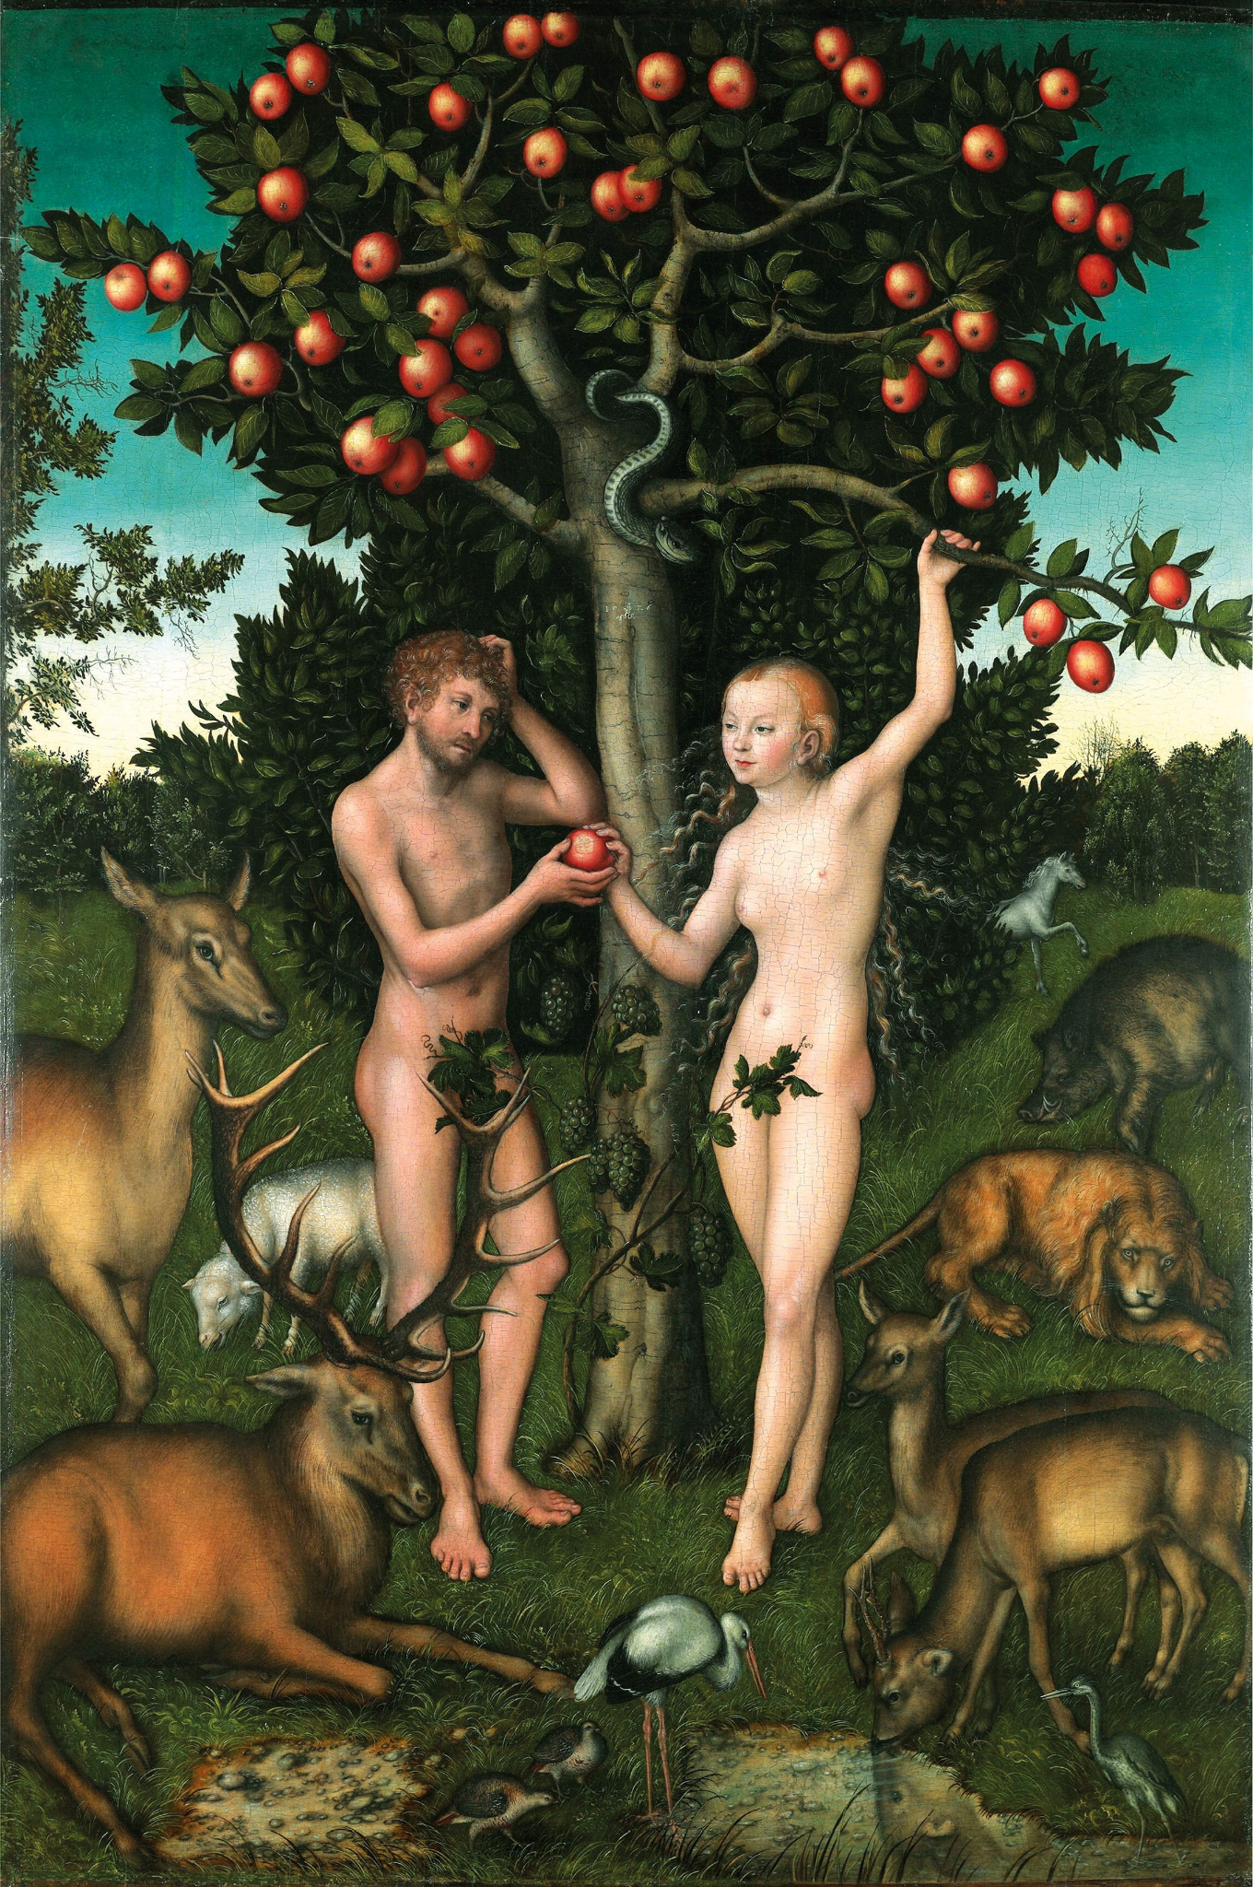
Evolution:
For the Bible Tells Me So

Slide 2
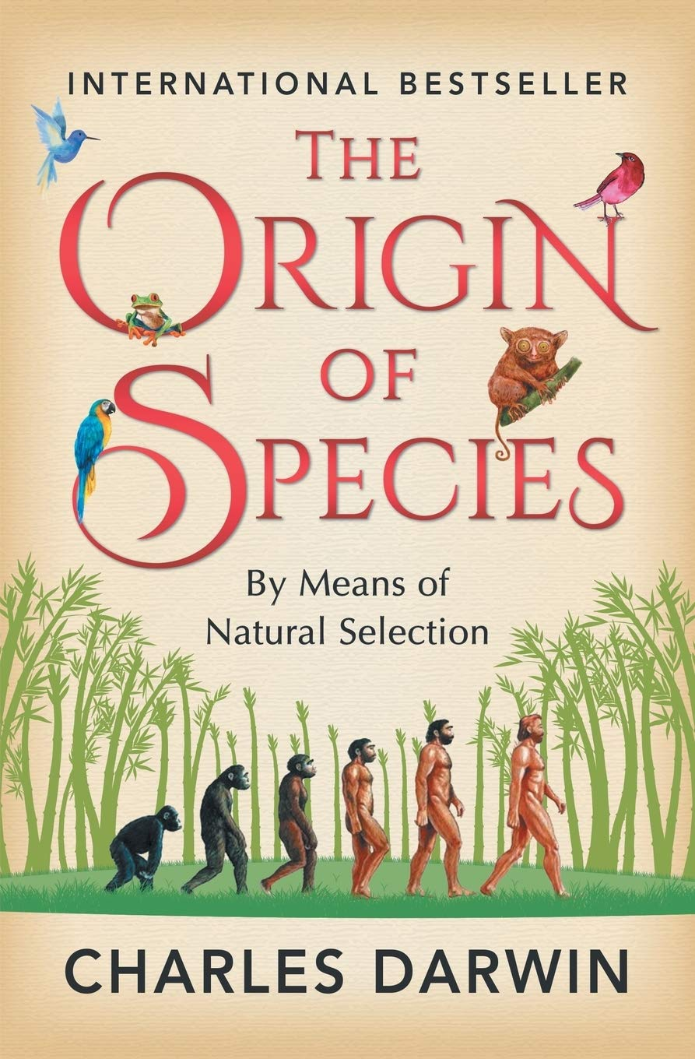
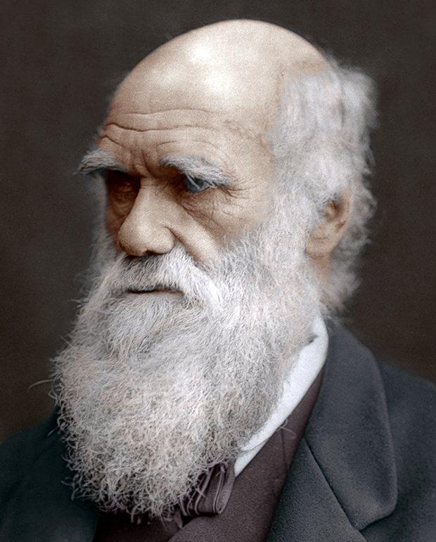
Science Lesson #1
A Scientific Introduction to the Theory of Evolution
2 Class Periods

Slide 3
A Scientific Perspective: Introducing Evolution
Pre-Lesson
Prior Knowledge:
This lesson is designed to take place at the start of the 9th grade Biology Evolution Unit.
The purpose of this first lesson is to introduce students to the scientific theory of evolution and to the scientists that contributed to its discovery, as well as begin to understand how evolution occurs (Should take about 2, 50 min class periods)
HW Due Prior to Lesson 1: Superbugs: A Silent Health Emergency
Questions to Discuss:
Antibiotics are supposed to be good. What is causing antibiotics to not be so “good” anymore? Give an example from the article.
Define antibiotic resistance.
The author mentioned the terms “evolution” and “survival of the fittest”: explain in your own words how you think these two terms are related to antibiotic resistance.
Notes:
Discuss Homework

Slide 4
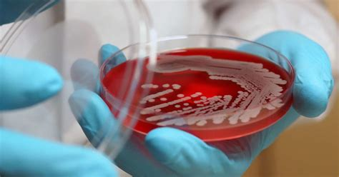
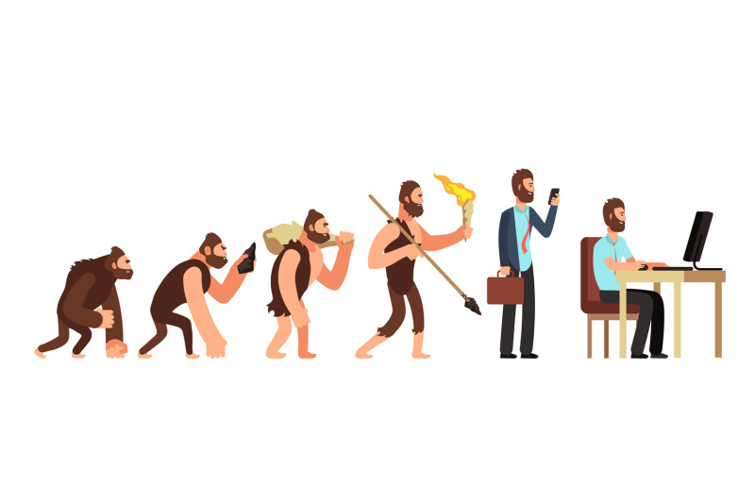
A Scientific Perspective: Introducing Evolution
Lesson 1
Class Discussion: Discuss HW article answers. Transition to term “evolution”: what does it mean when something “evolves”?
What are some example of things that “change over time”?
How has bacteria evolved, according to the article?
Think/Pair/Share: What do you know about the evolution of life? Has life changed in the past 100 years? 1000 years? 1 million years?
Write shared answers on board via concept map
Notes:
Discuss Homework

Slide 5
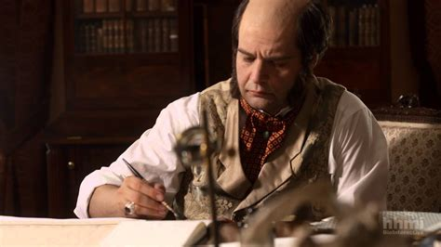
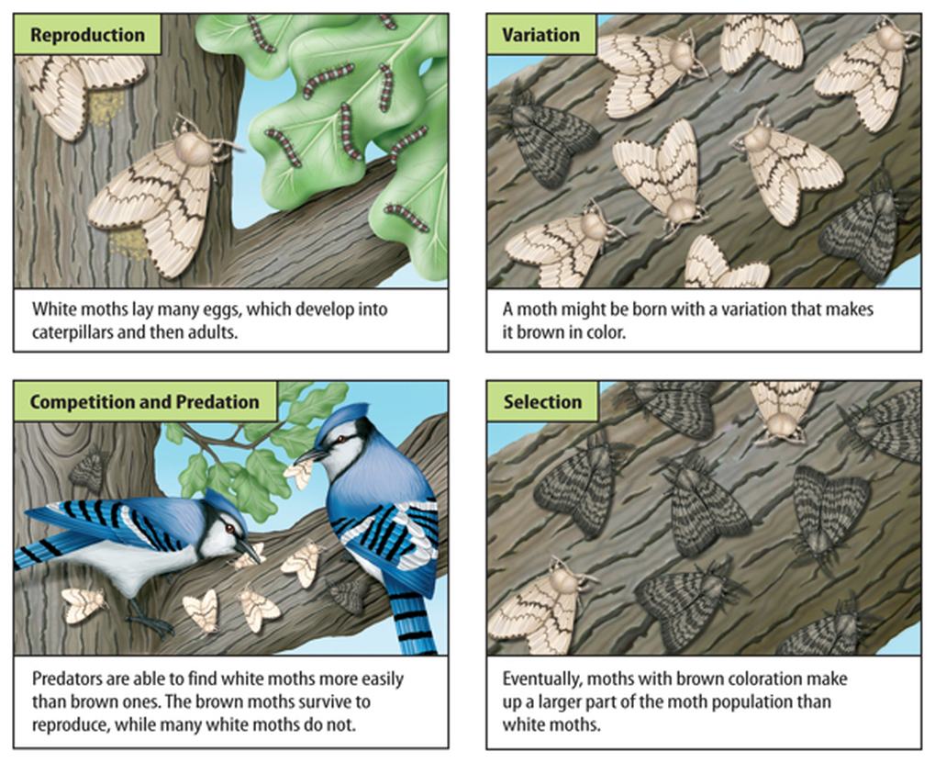
The “Discovery” of Evolution
Video: “The Origin of Species: The Making of a Theory”
Students will be taking notes on the two scientists they will be observing: Charles Darwin & Alfred Wallace
Mini Lecture: History of the “discovery” of the Theory of Evolution, Natural Selection and Descent with Modification
HW: Finish Notes (Recorded Video)
Notes:
HHMI BioInteractive episode

Slide 6
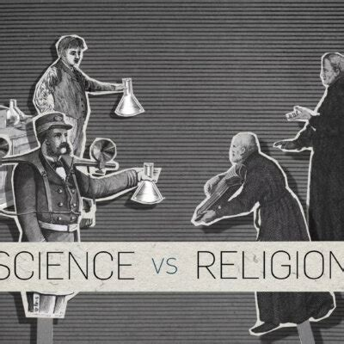
A Scientific Perspective:
Addressing Misconceptions in Evolution
Lesson 2
Do Now: The Theory of Evolution can be a challenging idea for religious people to understand. As a student in a Catholic school, what could the religious see as “conflicting” in the scientific theory? T/P/S
Video: The Draper-White Conflict Thesis
Students will make lists in 3 columns: Things they agree with/understand, Things they disagree with/find challenging, and things they have questions about
Fishbowl Activity
HW: Reflection Questions
Notes:
Discuss Homework
https://www.youtube.com/watch?v=ZLoZc5DIU9o

Slide 7
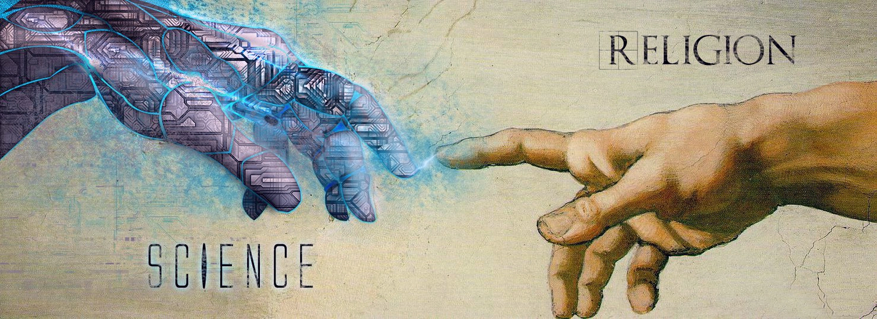
Class #2
On the Compatibility of Religion & Science
(Faith & Reason)

Slide 8
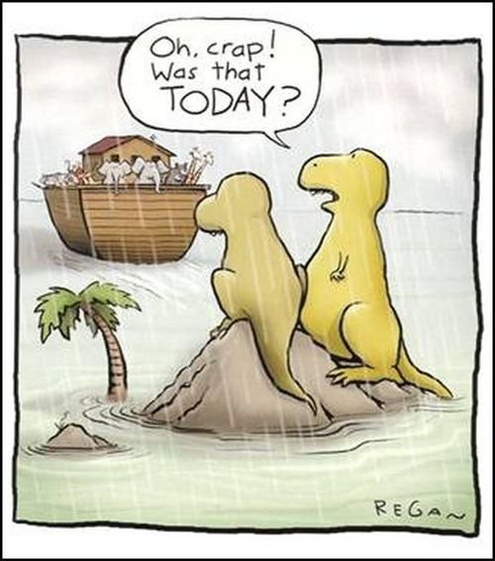

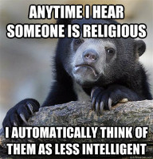
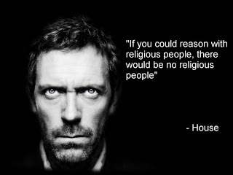

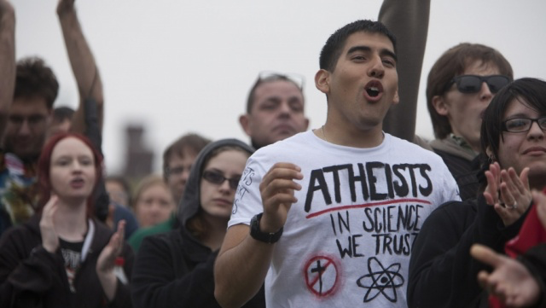

Notes:
Do Now:
True/False Quick Questions
1) The Catholic Church agrees that evolution is an acceptable theory.
2) It is only in the last decade since Pope Francis has declared that the Church accepts the connections between faith and science, such as evolution.

Slide 9

Basic Teachings on the Topic of Religion and Science in the Catholic Church
The Catechism teaches that there can never be any real conflict between faith and reason:
“Faith and science: Though faith is above reason, there can never be any real discrepancy between faith and reason. Since the same God who reveals mysteries and infuses faith has bestowed the light of reason on the human mind, God cannot deny himself, nor can truth ever contradict truth.
Consequently, methodical research in all branches of knowledge, provided it is carried out in a truly scientific manner and does not override moral laws, can never conflict with the faith, because the things of the world and the things of faith derive from the same God.
The humble and persevering investigator of the secrets of nature is being led, as it were, by the hand of God in spite of himself, for it is God, the conserver of all things, who made them what they are.” (CCC, 159)
Notes:
Discuss Homework

Slide 10

On Faith and Reason
This idea is not new; Vatican Council I, Dogmatic Constitution Dei Filius, in 1870, explains that faith and reason can never contradict one another since they both come from God.
“And, not only can faith and reason never be at variance with one another, but they also bring mutual help to each other, since right reasoning demonstrates the basis of faith and, illumined by its light, perfects the knowledge of divine things, while faith frees and protects reason from errors and provides it with manifold knowledge.” (Chap. 4)
Finally in the papal encyclical dedicated entirely to the relationship between faith and reason, John Paul II, writes of how faith and reason are essentially intertwined:
“Through philosophy’s work, the ability to speculate which is proper to the human intellect produces a rigorous mode of thought; and then in turn, through the logical coherence of the affirmations made and the organic unity of their content, it produces a systematic body of knowledge. In different cultural contexts and at different times, this process has yielded results which have produces systems of thought.” (Fides et Ratio, section 4)

Slide 11
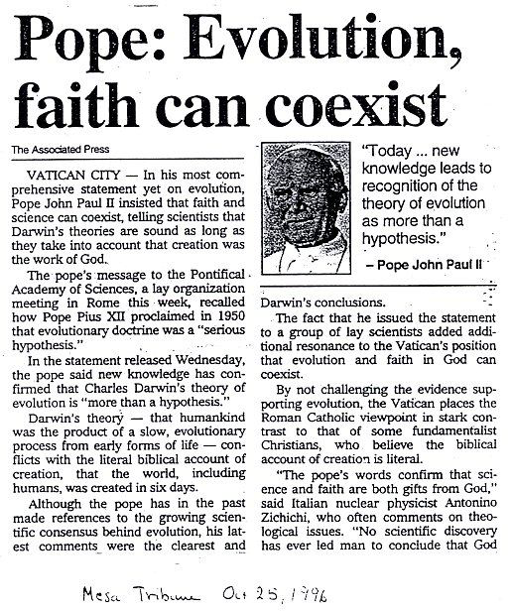
On Evolution
Pope John Paul II in his Message to the Pontifical Academy of Science, On Evolution (1996), explains that evolution is more than a ‘theory’ and is not in direct conflict with the Catholic faith:
"In his encyclical Humani Generis (1950), my predecessor Pius XII has already affirmed that there is no conflict between evolution and the doctrine of the faith regarding man and his vocation, provided that we do not lose sight of certain fixed points.... some new findings lead us toward the recognition of evolution as more than a hypothesis…” (Sections 3-4)

Slide 12
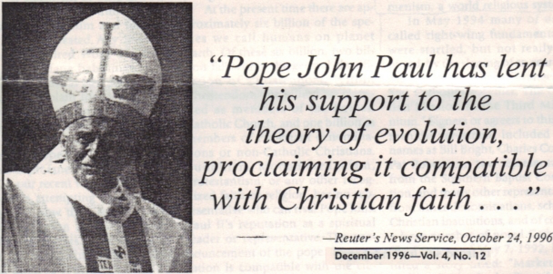
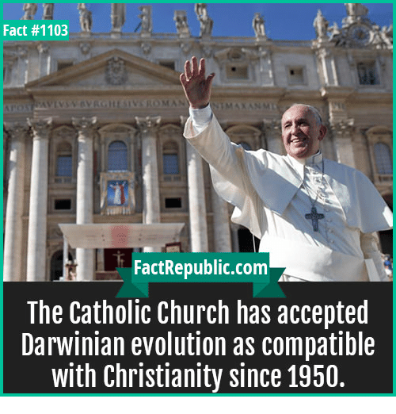
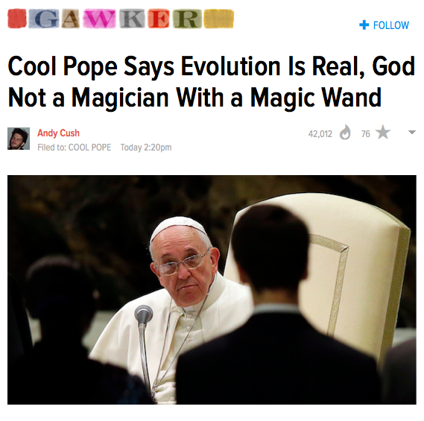
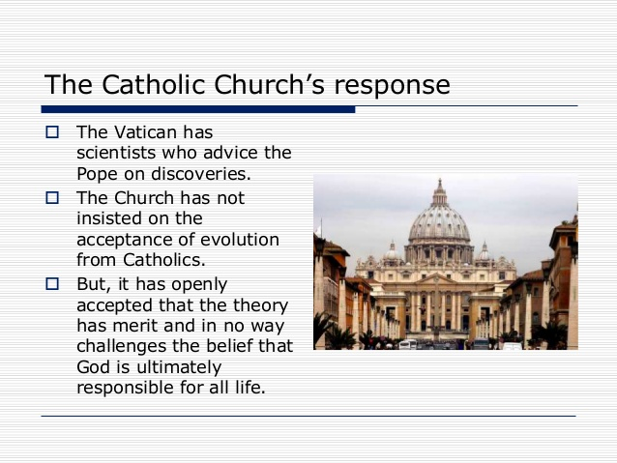
October 28, 2014

Slide 13

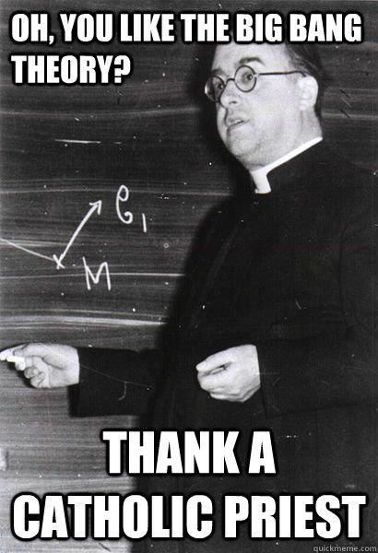
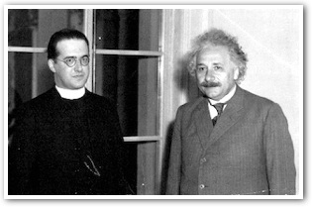
Georges Lemaître, (1894-1966), Belgian cosmologist, Catholic priest, and father of the Big Bang theory.

Slide 14
History of the Debate
Galileo (1564-1642) The “Bible teaches us how to go to heaven, not how the heavens go.” Galileo’s theory that the earth was not the center of the universe, but revolved around the sun, was heretical in the Catholic Church. He was brought in front of the Inquisition. It is said that his last words were, “And yet it moves,” referring to the earth.
Flat Earth Theory (from Ancients until Copernicus in 16th C.)
Newton (1643-1727) furthered study of astronomy, laws of motion, gravity
Young Earth Theory (17th C. revived in late 20th C.)
Creationism (19th C.)
Darwin (1809-1882) – Theory of Evolution
William Jennings Bryan (1860-1925) challenged Genesis with age of earth
Tennessee v. John Scopes (1925) – Bio teacher accused of teaching evolution when it was banned.
The study of science & religion gained popularity in the 1980s.
Areas for future work:
Neurotheology—study brains to learn about religious experience, i.e.
Genetics: Human Genome Project—ethics of genetic engineering

Slide 15
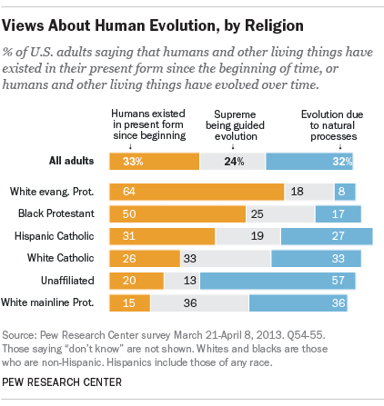
Notes:
Masci, David. 5 Fact About Evolution and Religion. Pew Research Center. Pewresearch.org. 30 October 2014. Web. http://www.pewresearch.org/fact-tank/2014/10/30/5-facts-about-evolution-and-religion/

Slide 16
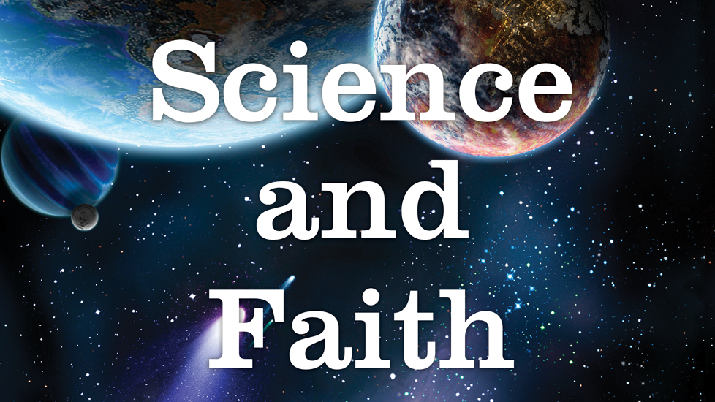
3 Ways of Responding to the Supposed Conflict Between Science and Religion
1) Against - both can’t win, either/or
2) Towards: 2 Eyes to Truth, both help to answer big questions
3) Away: Compartmentalized, totally separate, have nothing to do with one another

Slide 17
1) Against
Atheism, ie. Richard Dawkins (published The Selfish Gene in 1976, helps to explain altruism) – in what’s known as the “new atheism”, he believes science and religion cannot peacefully coexist.
Creationism – The idea that general conclusions about the universe are stated in the Bible, based on a literal reading of the Bible as a timeless, supernatural guide. Science is not needed to explain the universe.
This is related to the Young Earth Theory, which says that the earth is 10,000 yrs. old (not 5 billion). For these believers, creation occurred in 6 days literally. The Great flood can explain fossils etc. But then why does the earth seem old? God made tree rings, navels, and smooth stones because that’s the way he wanted them.
Some physics hypotheses for the Big Bang do not allow for God:
Parent Universes (bubble on a prior universe that broke off and caused a black hole in that universe)
Vacuum Genesis—negative matter became positive, particles came into Existence
Oscillating Universe—expands then collapses to pt. of singularity, then re-Expands
Multi-verse—we’re not the only version of reality in the universe

Slide 18
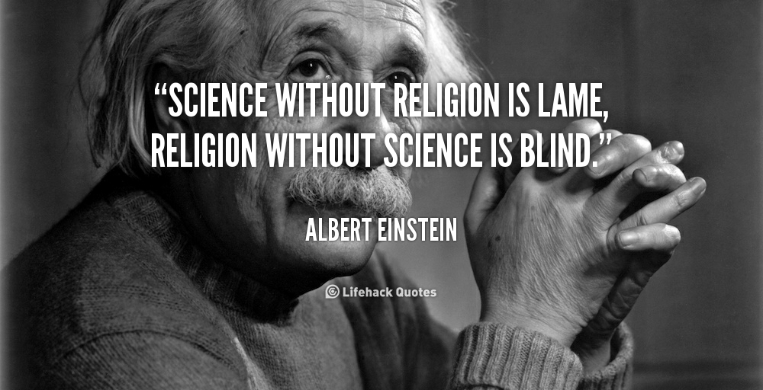
2) Towards: 2 Eyes to Truth
Einstein (1879-1955): Conflict between science and religion is impossible. Science is descriptive not normative, and religion can’t speak of facts and relationships. The two work in a mutually beneficial relationship. Religion determines the goal, but science determines the means of achieving it. Einstein didn’t believe in a personal God, but he’s religious in that he strives for virtuous goals.

Slide 19
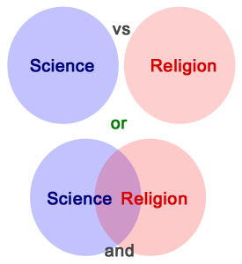
2 – Towards (cont’d)
How can God be involved in the evolutionary process?
God controls events that appear to be random (quantum physics, chaos theory, or butterfly effect—imperceptible level of God’s intervention),
God designed a system of law and chance, or
God influences events without controlling them.
This is important because evolution must respect human dignity to be accepted by the Church.
Intelligent Design: To have design, mere chance must be eliminated. This theory says that the current theories of origins can’t account for all the design in the world (the eye, a propeller seed), so there must have been an intelligent being to create it all. Like Aquinas, the traditional explanation would be, “Look how everything works out so well---there must be a God!”

Slide 20

3) Away
Langdon Gilkey (1919-2004) said that the 2 are independent fields. Science asks the question of "how?" while Religion asks "why?”
There is no reason for the two fields of inquiry to overlap.
Famous physicist Stephen Hawking often supported ideas between this and atheism.

Slide 21

Catholic Teaching
Closest to the 2nd view.
In “Evolution and the Living God,” Pope John Paul II writes that evolution is accepted as fact (more than hypothesis). He says we shouldn’t be threatened by evolution, as Catholics also maintain a belief in the soul, created by God. This is known as Theistic Evolution. It is evolution guided by or at least began by God.

Slide 22
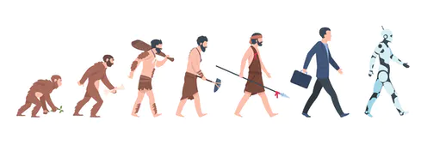
QUIZ/ACTIVITY
Answer: If you had a roommate in college who believed in Creationism, what would they believe about the Bible and the science of creation? How might you react to this information? If they asked you what you believe about creation, what would you say?
Activity: Be prepared to share a line or two of your thinking with the class or to ask a question of your classmates.

